Slide 1
December 10, 2020
Working with
Refugee State Coordinators
A Webinar for Remote Placement Community Partners
Facilitator: Elizabeth Cirin Cione
Remote Placement Coordinator

Slide 2
1
2
3
Zoom Features
Chat
Q&A
Raise Hand
Interact with presenters and attendees by:
Typing into the chat box
Asking questions in the Q&A
Raising your hand
The Zoom toolbar is at the bottom of your screen!

Slide 3
Identify where you can find your SRC and SRHC’s contact information
1
Learning
Objectives
Understand the SRC/SRHC’s role in remote placement
2
By the end of this webinar, you will be able to:
Use the new USCCB resources to coordinate with your SRC/SRHC and local community
3
Brainstorm strategies for further engagement with your SRC/SRHC
4

Slide 4
Office of Refugee Resettlement (ORR)
State Refugee Coordinator (SRC)
Key Terms
ORR is a division of the U.S. Department of Health & Human Services Office of the Administration for Children & Families. ORR provides programming and funding opportunities to federal agencies, state partners, technical assistance providers, and resettlement agencies.
SRCs are responsible for implementing state plans for refugee resettlement, managing grants, and working with national, local, and community partners to maximize resources for refugee resettlement.
Office of Refugee Resettlement
1
2
State Refugee Coordinator
State Refugee Health Coordinator (SRHC)
State Refugee Health Coordinator
3
SRHCs complements the work of the SRC and provide health expertise to manage, coordinate, and provide technical assistance to refugee health services in the state.

Slide 5
Participated in several calls with SRCs to explain the Remote Placement program and answer questions
1
USCCB Initiatives
Re-vamped outreach and onboarding process to involve SRCs/SRHCs at greater level
2
Over the past two years, USCCB has been working closely with SRCs/SRHCs to strengthen communication efforts.
Developed resources for SRCs/SRHCs to utilize when working with community partners
3

Slide 6
Role of the SRC and SRHC:
This process will look different in every state:
Administers ORR funding to provide cash and medical assistance benefits
Coordinates between refugee funded services and other state-administered programs like SNAP, Medicaid, etc.
Contracts with local agencies to deliver employment, case management, ESL, and health screening services
Participate with affiliate resettlement offices on quarterly consultations
Manage the medical screening program
Create partnerships to ensure sustainability of services
Provide technical assistance on refugee concerns
Troubleshoot issues related to programming or state services
Address inquiries associated with their state’s refugee resettlement

Slide 7
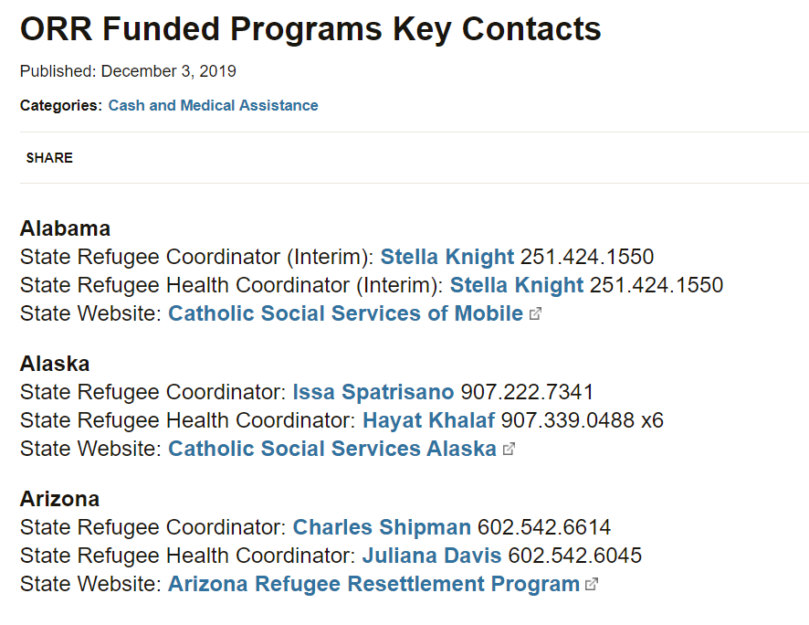
Where do I find my SRC/SRHC’s contact info?
https://www.acf.hhs.gov/orr/resource/orr-funded-programs-key-contacts
Tip…
Google “ORR SRC” and it will be the first result

Slide 8
SRC/SRHC’s Role in Community Partner Outreach & Onboarding
In 2019, USCCB updated the process for communicating and coordinating with SRC/SRHC on remote placement
Changes were made in order to involve the coordinators at a greater level
When conducting outreach for a new community partner, USCCB informs SRC/SRHC of outreach efforts and may coordinate in order to find a suitable agency
Upon PRM approval of partner, USCCB facilitates a call between SRC/SRHC, and community partner
Facilitate introductions
Learn about state enrollment process
Answer questions

Slide 9
Ongoing Communication between SRC/SRHC & Community Partner
Following efforts to ensure SRC/SRHC knowledge of the Remote Placement program and the increase in coordination at the headquarters level, we want to encourage community partners of all size to ensure they are also engaging in dialogue with their SRC/SRHC.
SRCs/SRHCs typically want to stay informed of what is happening in remote placement locations
SRCs/SRHCs are great resources for community partners and may help with questions or issues that your agency may experience

Slide 10
Establish regular communication
1
Strategies for Engagement
Manage expectations
2
Collaborate on problems
3

Slide 11
Establishing Regular Communication
Establishing regular communication is a great step to engaging productively with your SRC/SRHC.
Below are three examples of current communication models:
Example #1: A former affiliate closed a few years ago and subsequently become a community partner. As arrivals have recently increased to this partner, the SRC wants to be in frequent communication. The agency has a standing monthly call with the SRC/SRHC. The partner is invited to participate in state-wide meeting and does so when possible.
Example #2: A once larger community partner now resettles 1-3 cases per year. Communication between the state and partner used to be more frequent but has since declined. The SRC is aware of the systems that are in place to serve cases and asks that the partner reach out if arrivals increase. The partner sends annual updates to the SRC and SRHC.
Example #3: A community partner has a variety of state programming and is in regular communication with state officials but not necessarily the SRC. However, the partner and SRC communicate on an as-needed basis or when issues arise.

Slide 12
Establishing Ongoing Communication:
Reach out to your SRC/SRHC and establish some form of regular communication
Methods and frequencies WILL look different for each partner!
Topics for conversation/updates can include:
Year to date arrivals/statistics
Trends identified amongst arrivals (U.S. Tie locations, nationalities, ethnicities, average family size, language, common medical conditions, etc.)
Reminder: keep general
Collaboration efforts with local stakeholders (education, social services, public safety, local government)
Challenges preventing adequate resettlement
Request for trainings/information
How your agency and local area are handling COVID-19

Slide 13
Strategies for Communication:
Keep SRC/SRHC informed of new staff and staff departures, as well as any major changes in agency programming or local area initiatives
Invite SRC/SRHC to participate or call into local meetings, presentations or information sessions relevant to refugee resettlement
Use the new fiscal year, new year, or World Refugee Day as an opportunity to connect
Ask if there are state-wide or regional meetings (QC or otherwise) that you can participate in
Share your successes!

Slide 14
Managing Expectations
Misunderstandings and miscommunications may arise when expectations are not clear
Not having regular contact with your SRC/SRHC will lead to misplaced expectations
Being proactive is your best bet!
Be upfront and clear about your agency’s capacity and what resettlement looks like in your local community
Monthly calls may not be necessary for sites resettling 3 cases per year

Slide 15
Quarterly Consultations
Are remote placement partners required to participate in quarterly consultations?
Quarterly Consultations (QC) are formalized communication efforts that affiliate offices are required to participate in. These meetings have specific agenda items and attendance requirements that affiliate offices must show compliance with. As of FY 2021, remote placement partners are not required to participate in them.
SRC/SRHC may invite you to participate in a state or regional call – feel free!

Slide 16
When to refer to USCCB
SRCs/SRHCs may have questions or concerns that you are unable to answer…
Refer your SRC/SRHC to USCCB when:
They have questions on other remote placement sites in the state
They have questions or concerns on R&P/Remote Placement in general
They want clarification on whether an affiliate requirement applies to a community partner (and you are not sure)
They are looking for pre-arrival reports or want to be notified of each new arrival

Slide 17
Collaborate: When to Contact your State Refugee Coordinator
Excessive or systemic delays with social services (TANF, Food Stamps, Medicaid, WIC, SSI)
Denial in services that you believe are not accurate
Confusion or misunderstandings about eligibility or client identification documents
Notification about Class A Medical Cases
Notification about Attached Refugee Minor 90 Day Evaluation Reports
Notification about a particularly vulnerable case

Slide 18
Case Study:
Troubleshooting delays with your State Refugee Coordinator
A remote placement partner receives two refugee cases after not resettling for several years. After the cases arrive, the community partner takes the clients to the local DHS to apply for benefits. The DHS staff that worked on the previous cases are no longer there, and the current office believes the clients are not eligible for food stamps, TANF and health benefits. The staff repeatedly ask for proof of citizenship. The community partner knows that refugees are eligible for these benefits, and contacts the SRC for help. The SRC reaches out to the local office to provide guidance, and helps facilitate the client’s application.

Slide 19
Collaborate: When to Contact your State Refugee Health Coordinator
Difficulty establishing a refugee health screening
Information on how to request an appointment
Regular delays with scheduling refugee health screening appointments
Confusion regarding documentation required at health departments
If a client received emergency medical assistance while en route to final destination and has associated medical bills
Notification about a particularly vulnerable case or Class A medical cases

Slide 20
Case Study:
Identifying where to establish a health screening in a new location
An experienced remote placement community partner resettles several cases a year in the city where the agency is located. The agency receives a case for the neighboring county, where they do not have an established refugee health screening provider. The agency wants to make sure the refugee receives health services in their local community, and reaches out to the SRHC for guidance. The SRHC provides the community partner with the information on a contracted health provider in the area who can provide the services, and helps to facilitate an appointment.

Slide 21
Resources
In FY 2019, USCCB developed two materials for community stakeholders to utilize:
1
State Refugee Coordination Manual
Designed for State Refugee and State Refugee Health Coordinators
Provides info on remote placements, program administration, & USCCB’s process for communicating with state officials
Refugee Resettlement in my Community
Designed for community members and stakeholders
Explains refugee resettlement and remote placements
2

Slide 22
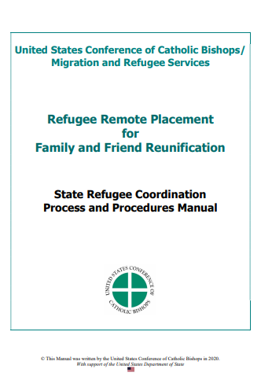
State Refugee Coordination Manual
The goal of the SCORR Manual is to help SRCs/SRHCs understand:
Differences between community partners and traditional resettlement affiliates;
The state’s role in community partner outreach and onboarding;
Ongoing communication between the state and new or existing partners;
Ongoing communication between the state and USCCB.
Community Partners can utilize this resource in their collaboration with SRCs/SRHCs. If your state partners have questions on remote placement, this resource is a great place to start!
Please do not share this resource widely.

Slide 23
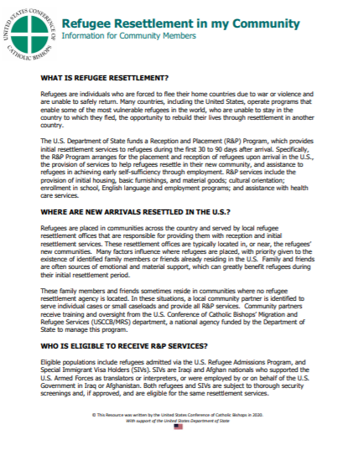
Refugee Resettlement in my Community
Community members and stakeholders may have questions on refugee resettlement or wonder why a remote placement is destined for their city
This material provides:
Basics of refugee resettlement and R&P services
Information on how new arrivals are resettled
Who is eligible to receive R&P services
Community partners are encouraged to distribute this upon request or where appropriate.

Slide 24
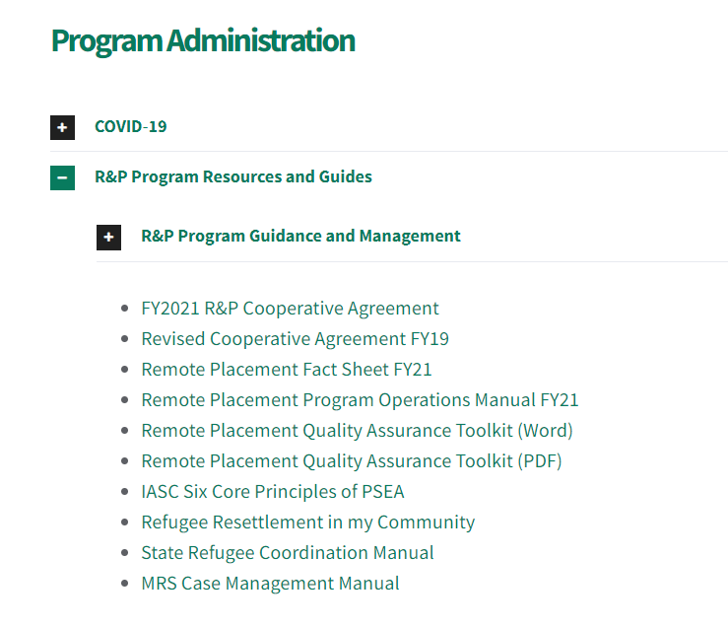
Where do I find these materials?
https://mrsconnect.org/remote-placement/case-file-forms/
SRC/SRHCs have access to these materials through their private ORR website.

Slide 25
Action Item
When was the last time I touched base with my state coordinators…?
Ask your SRC/SRHC if you could establish a form of regular contact in the new year
Provide a summary of your FY 2020 resettlement

Slide 26
Thank you!
Questions?
ecione@usccb.org

