Slide 1

Cash and In-Kind (Client Level)
USCCB
Resettlement Services

Slide 2


Presenter
Yasmin Hussein
Field Support Coordinator
MRS, USCCB

Slide 3
Zoom Features

Slide 4

Webinar Agenda
Overview of Cash and In-Kind (R&P & Match Grant Programs)
Cash and In-Kind (R&P)
  Cooperative Agreement
  Documentation Overview of Cash and In-Kind support for R&P
Cash and In-Kind (Match Grant)
  Match Grant Guidelines
  Documentation Overview of Cash and In-Kind support for MG
  Examples of allowable and unallowable matches
  Valuation of “In-Kind” Match
    Donations
    Volunteers

Slide 5
Learning Objectives
At the end of this webinar, you will be able to…
Demonstrate how to thoroughly complete required cash & in-kind forms
Discuss promising practices in documenting contributions
List which contributions are required in the client case file

Slide 6

Overview of Cash and In-Kind
Defining Cash and In-Kind
Cash vs. In-Kind
  What is the difference between Cash and In-Kind donations?
  What is considered a cash donation?
  What is considered an in-kind donation?
An MG case was given donated toys for their children, does this count as MG Cash Match, In-kind Match, or neither?
An MG case was given work clothes by a family member/US Tie. Does the Match Grant affiliate have to provide a donor letter to that family member including the date and valuation of the in-kind contribution?
Do all items or services donated have to be related to self sufficiency?
Can Staff and volunteer time spent on services provided for under the R&P program for refugee clients also be charged to the MG Program ?

Slide 7
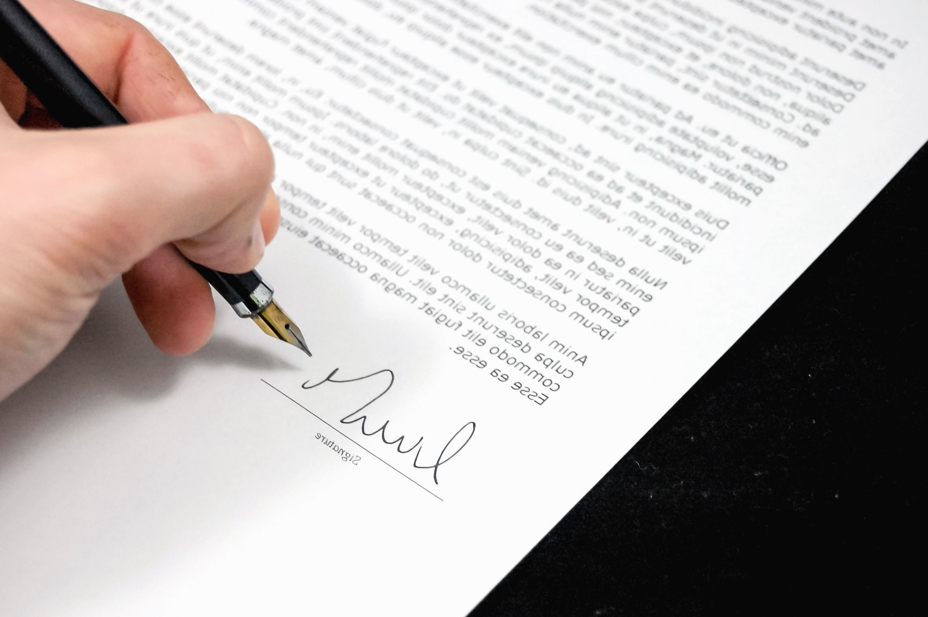
Cooperative Agreement
“a record of cash and in-kind support provided to meet the refugees' material needs, as stated in subsection 5.c.2)a), for at least the initial thirty (30)-day period, including clear acknowledgement by the adult member of the refugee case in receipt of cash, including pocket money, and in-kind support, and evidence that the amount provided either in cash or documented cash payments on behalf of the refugee case is equal to at least $975 times the number of individuals in that case and reflects the total Bureau R&P per capita amount spent on the refugee case;” (p.31)

Slide 8
Documentation of Cash and In-Kind (R&P)
  RF-20A (Cash and In-Kind Donations Record)
  RF-20B (Volunteer Services Record)
  RF-20C (Summary of Cash and In-Kind Contributions and Volunteer Services)
  RF-22 (R&P Supply Checklist)
  Form created by Affiliate to capture client acknowledgement

Slide 9
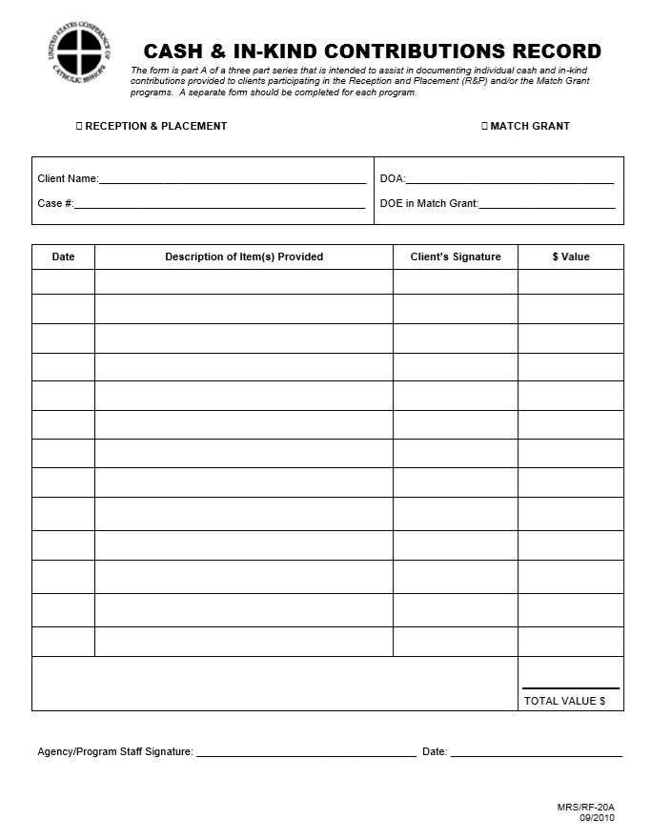
RF-20A (Cash and In-Kind Donations Record)

Slide 10
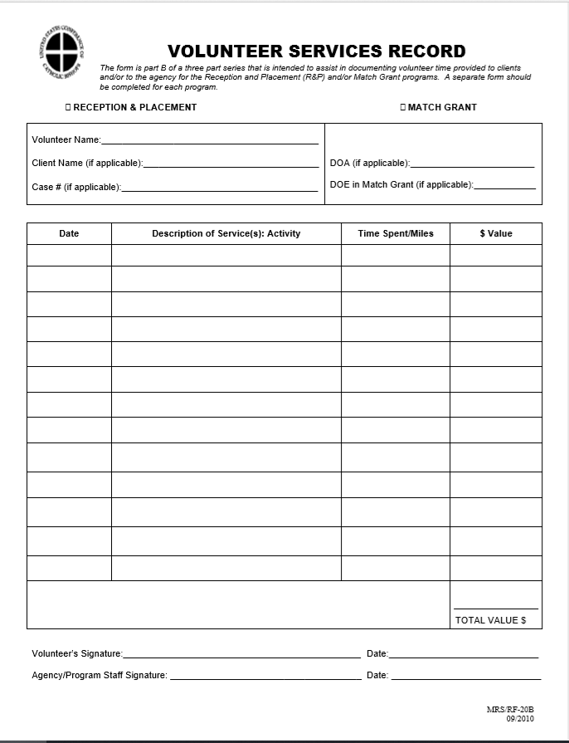
RF-20B (Volunteer Services Record)

Slide 11
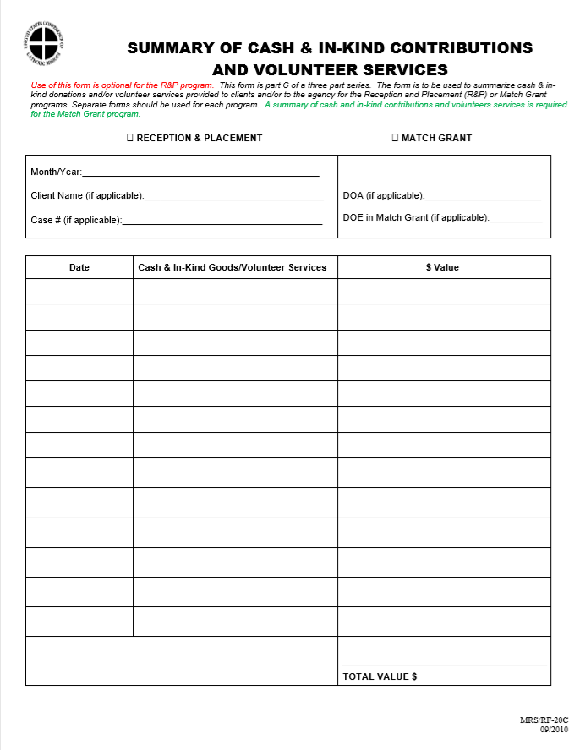
RF-20C (Summary of Cash and In-Kind Contributions and Volunteer Services)

Slide 12
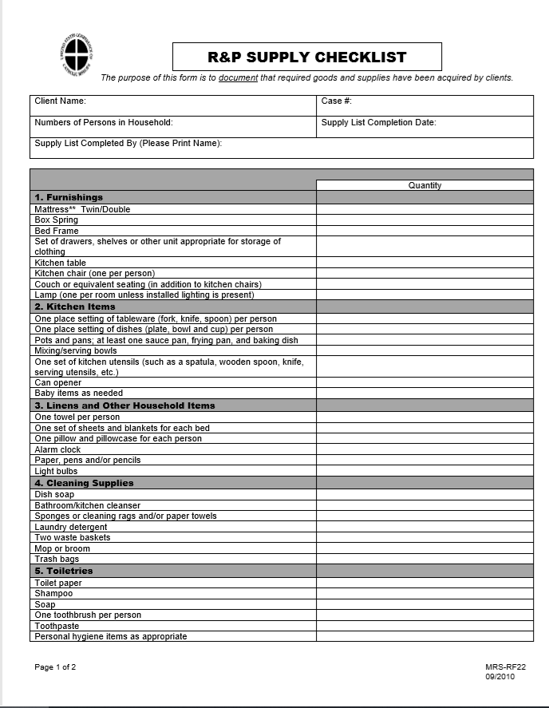
RF-22 (R&P Supply Checklist)

Slide 13
Match Grant Guidelines
Materials
Cash and Material Disbursements: Each file will have a summary sheet of all cash and in-kind contributions allocable to the MG Program and disbursed to the case. All noted cash or check disbursements must include the initials of an adult member of the case (p.7, FY 2020 ORR VOLUNTARY AGENCIES MATCHING GRANT PROGRAM GUIDELINES)
Match Cash match must be donated to the MG Program and may be from private or corporate donation, or any other non-federal source (45 CFR 75.306). The grant application must identify both the source(s) and the proposed use(s) for the cash match. Contributions of goods and services cannot be considered “cash”. Third party in-kind contributions are defined as the value of non-cash contributions that benefit a federally assisted project or program that are contributed by non-federal third parties without charge to the recipient, the sub-recipient, or a cost-type contractor under the grant or sub-award (45 CFR 75.2). For MG Program purposes in-kind contributions, or match, may be in the form of volunteer services; loaned equipment or space; or donated land, buildings, equipment, or supplies that directly benefit and are specifically identifiable to the MG Program (45 CFR 75.306). (p.15, FY 2020 ORR VOLUNTARY AGENCIES MATCHING GRANT PROGRAM GUIDELINES)

Slide 14


Documentation of Cash and In-Kind(Match Grant)
Record of MG cash and in-kind donations provided to the case
  USCCB/MRS “Cash and In-Kind Contributions Record” or comparable diocesan form.
    Documentation must include client signature and date of signature.
    Documentation must include description of item(s) received and item valuation.
Record of volunteer services provided to the case
  USCCB/MRS “Volunteer Services Record” or comparable diocesan form. Documentation must include:
    Date of service
    Description of volunteer services provided to the specific client/case.
    Time spent conducting service/activity.
    Miles driven (when applicable)
    Total value of service and/or mileage
    Volunteer signature and date signed by volunteer.
    Outcome(s), and next steps (as appropriate) must be included in the client case file
Materials
Electronic volunteer records are allowable.

Slide 15

Examples of allowable cash matches
CASH MATCH = funds contributed from non-federal sources.
Cash donated by community/churches for clients’ rent, utilities, phone, food and material goods
Cash raised from program income, i.e. interpreter bank, and used for MG activities
Staff salaries/fringe benefits paid for by non-federal source, i.e. agency, private, state/local funding. For example, if the agency receives foundation funding to offer financial literacy classes that MG clients take, a portion of instructor salaries could be counted towards match.
Direct operating expenses, such as rent, utilities, communications, supplies, equipment, transportation paid for by non-federal source
Indirect costs paid for by the agency. Costs must be charged using a federally approved indirect cost rate or an agency allocation plan approved by USCCB.
Materials

Slide 16
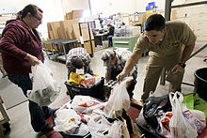
Examples of allowable in-kind matches
IN-KIND MATCH = non-cash contributions from non-federal sources.
Materials
Donated services (time and mileage)
• Volunteers or relatives assisting with MG activities such as case management, employment services, ESL tutoring, interpreting, health services, social adjustment services and clerical functions to support program activities
• Volunteer instructors for ESL, job readiness training
• Interns performing MG activities
• Donated childcare
Donated items or goods for MG clients
• Clothing, i.e. work clothing
• Household items, i.e. desks, computer
• ESL books, instructional materials, dictionaries
• Bus passes, cars, bicycles/helmets/bike locks
• Safety goggles, work shoes, tools
• Employment training materials
Donated supplies, space or land, donated or loaned equipment for MG program operation
• Donated warehouse space (% used for MG related items)
• Donated space for MG activities (i.e. case management, employment services, ESL training)
• Donated computers, copiers, printer, phones, vehicles used to operate the MG program

Slide 17

Examples of unallowable matches
An in-kind donation of entertainment.
A donated computer without paperwork signed by the MG client indicating receipt of the item.
ESL training a MG client receives that is funded by a state social services grant from ORR
A volunteer spends two hours taking a refugee MG client to his/her initial health screening.
Relatives of a MG client provide housing in their own residence to the client during the MG service period.
The cost of housing cannot be counted as match because it is not allowable per the ORR MG Program guidelines. However, if the cost for the relative’s residence increased as a result of housing the MG client, the amount of the increase could be counted as in-kind.
Materials

Slide 18
In-Kind Donations
Match Grant Guidelines (p.15-16)
Valuation
Donated supplies may include such items as expendable property, office supplies (unless treated as an indirect cost), laboratory supplies, household furniture and supplies, or workshop and classroom supplies. The value assigned to donated supplies must be reasonable and cannot exceed the fair market value of the supplies at the time of donation.
Must be reasonable and based on the local fair market value of the items at the time of donation.
Usually values are assigned to in-kind goods using local Goodwill or Salvation Army type standards or lists.
These standards or reference documents used in valuation of in-kind goods must be included the Match Grant Policy folder, as described in Section 4.3. (Match Grant POM)
The quantity of each item donated is documented and assigned the appropriate value.

Slide 19

Volunteer Services
Match Grant Guideline (p.16)
Valuation
Volunteer Services - 45 CFR 75.306 (e) and (f) Rates for donated services used to satisfy a matching or cost-sharing requirement must be consistent with those paid for similar work in the organization. In those instances in which the required skills are not found in the agency, rates must be consistent with those paid for similar work in the labor market in which the agency would compete for the kind of services involved. When an employer other than the agency furnishes the services of an employee, the services must be valued at the employee’s regular rate of pay. Only the amount representing an amount consistent with the function performed are allowable, e.g., if a doctor serves as a receptionist, only the amount that would be allowable for a receptionist is allowable as a contribution to the grant. Fringe benefits consistent with those that would be paid by the employing organization that are reasonable, allowable, and allocable may be included in the valuation.
Volunteer services
Volunteer Mileage.
Volunteers from other employers.

Slide 20
Question & Answer

Slide 21
Send follow up questions to: yhussein@usccb.org
Evaluation Survey Link:
XXX

