Slide 1





November 19, 2020
2nd Amendment to the MG Guidelines
FY 2021
Notes:
You should be able to see in the chat box a link to the MG Guidleines page in MRS Connect where we have saved all documents/resources related to the 2nd Amendment. You do need to be logged into the MRS Connect to view the resources.

Slide 2
1
2
3
Zoom Features
Chat
Q&A
Raise Hand
Interact with presenters and attendees by:
Typing into the chat box
Raising your hand
The Zoom toolbar is at the bottom of your screen!

Slide 3
Today’s Agenda
1
Activation of a Funding Exception
2
Waiver of the Fixed Match Requirement
3
Extended Services for MG Clients
4
Questions

Slide 4
Explain the three flexibilities awarded in the 2nd Amendment to the MG Guidelines
1
Learning
Objectives
Understand the changes ORR made between the 1st Amendment and the 2nd Amendment
2
By the end of this webinar, you will be able to:
Clearly describe how your agency is being funded for Q1
3

Slide 5
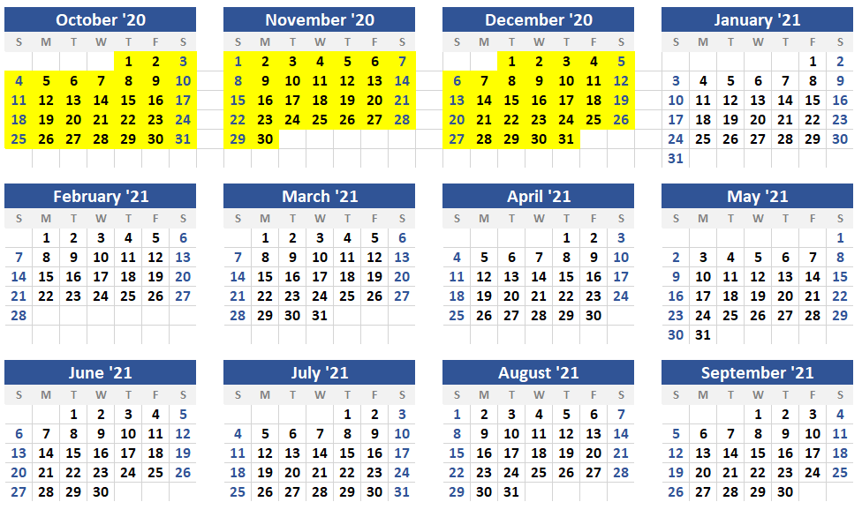
Duration of the 2nd Amendment
Q1 of FY2021 (10/1/2020 – 12/31/2020)
Possible extension to Q2 pending updated guidance from ORR

Slide 6
Activation of a Funding Exception

Slide 7
Activation of a Funding Exception
Each agency is guaranteed 75% of Q1 funding regardless of enrollments/extensions
ORR has guaranteed 75% of USCCB’s Match Grant award for the first quarter of FY2021 based on each agency’s approved enrollment base
This is a funding guarantee not a funding cap
Dual purpose: serving clients and maintaining capacity
New Guidance: All MG agencies regardless of enrollments or extensions will have access to 75% of their first quarter’s funding.
Expenditures beyond 75% must be tied to enrollments/extensions

Slide 8
Activation of a Funding Exception
Example
FY2021 Enrollment Base | Q1 Slot Allocation | 75% of Q1 Slot Allocation | Tranche 1 | Remaining Q1 Funding (above 75%)
400 | 100 | 75 | $177,300 | $59,100
100% of this agency’s Q1 funding is $236,400 (100 x $2,364)
They may access $177,300, without any enrollments or extended cases
All spending above $177,300 must be tied to actual enrollments or extended services
Agencies must contact MRSMatchGrant@USCCB.org for approval to spend past the 75% funding guarantee
REMINDER: You are not earning money based on enrollments, you are given a lump sum that you cannot spend beyond

Slide 9
Activation of a Funding Exception
Allowable Expenditures
Note: The utilization of the tranche funding is entirely at the discretion of each agency; however, funds must be utilized for legitimate MG program activities.
Client Services
New Enrollments (budget for full 180-day service period)
Extended Services
Local Admin Costs
Staff time for program strengthening activities: e.g. preparing for potential growth opportunities under an expanded MG program – resource development, volunteer outreach, employer outreach, non-R&P outreach, research into new match sources, case file quality assurance, USCCB eLearning course and other webinars
Agency occupancy expenses (rent and utilities) – should be charged to MG per your agency’s normal procedures
USCCB must approve all purchase above $5,000 unless it was included in your MG budget

Slide 10
Activation of a Funding Exception
Q2 Expectations
Option 1: Return to per capita funding allocation of $2,364 per actual enrollment starting 1/1/2021
Option 2: Extension of Flexibilities through Q2 (1/1/2021 - 3/31/2021)
Note: Spending beyond 100% of your Q1 award is done at the agency’s own risk. Be mindful that expenses related to the full 180-day service period should be covered by funds released

Slide 11
Waiver of the Fixed Match Requirement

Slide 12
Match Waiver
Waiver for Q1 Expenditures
The matching requirement for Q1 of FY2021 (10/1/2020 – 12/31/2020) has been waived
Match is not required – however any match collected must be documented and reported as usual
Any match collected during Q1 can be used to meet the match requirement for the remaining three quarters of FY2021

Slide 13
Extended Services

Slide 14
Extended Services
Two types of Extended Services:
Clients within 180-day Service Period
Clients outside 180-day service period
Spending beyond the $2,364 per capita rate in order to meet a client’s core maintenance needs
Client reaches the end of their 180-day service period and is still not Self-Sufficient
(e.g. paying for rent after day 120)
Agency may provide a 30-day extension of MG services to continue to assist clients towards the goal of self-sufficiency

Slide 15
Extended Services
Client Eligibility for 30 day extensions
Eligible | Not Eligible
Case was originally enrolled in MG between 10/1/2019 – 12/31/2020 | Case was originally enrolled before 10/1/2019
Case is currently not self-sufficient | Case is currently self-sufficient
New Guidance: Clients received/are receiving unemployment insurance or other COVID-19 emergency impact payments | Case has received/is receiving public cash assistance (RCA, TANF etc.) *unless they are no longer eligible

Slide 16
Extended Services
Extension Period
Extensions last for a period of 30 days
Services may be extended more than once, as long as the case remains eligible
Cases may not be extended/re-extended after the end of Q1 (12/31/2020)
Extension/Self-Sufficiency reports for all cases extended or completing extensions within the month must be submitted in MRIS by the 5th of the following month.

Slide 17
Extended Services
Documenting Expenditures in MRIS
All costs related to cases extended on/after 10/1/2020 must be charged to FY2021. It does not matter in which fiscal year the case was originally enrolled into MG.
The process for submitting expenditures for extended services remains the same as the current monthly billing in MRIS.

Slide 18
Extended Services
Service Requirements and Case File Documentation
USCCB has created the following resources:
FY21 2nd Amendment to the MG Program Guidelines – Guidance Doc
FY21 MG Case File Requirements for Extended Cases
FY21 MG Case File Monitoring Tool for Extended Cases
FY21 MG Adjusted Client Agreement for Extended Cases

Slide 19
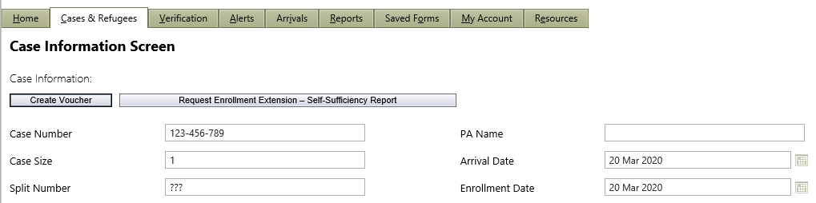
Extended Services – MRIS
First time extensions
To extend a case, complete the Enrollment Extension – Self-Sufficiency Report in MRIS. After 30 days you will need to evaluate the case and determine if the case will be re-extended for another 30-day period or if it will be closed.

Slide 20
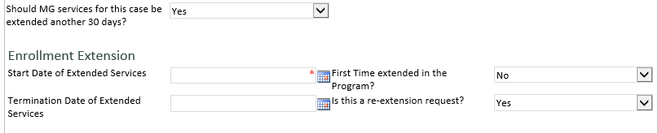
Extended Services - MRIS
To re-extend a case
To re-extend a case, complete the Enrollment Extension – Self Sufficiency Report in MRIS just as you did for the initial extension. This time you will say this is a “re-extension”.

Slide 21
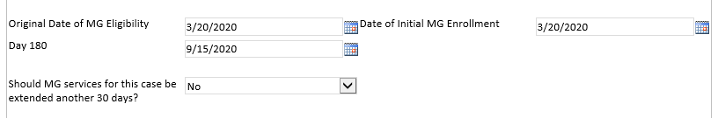
Extended Services - MRIS
To close an extended case
The close out report allows USCCB to collect the final employment and self-sufficiency information for the case. If a case is being closed, you will go into MRIS and complete another Enrollment Extension - Self-Sufficiency Report. When it asks you if this is an extension request you would select "no" and complete the rest of the requested fields. This show us that this case is no longer receiving extended services.

Slide 22



November 19, 2020
Thank you!
Do you have any questions?

