Slide 1
USRAP P-2 LAUTENBERG Program
Presentation 4

Slide 2
Purpose of presentation
Recall changes in application process
Refresh key points of Compliant AOR package
Review changes in AOR and PQ forms
Reiterate the Rejection procedure of non-compliant AORs
Let’s practice!

Slide 3
Launch of digital submissions
29 July 2020

Slide 4
Changes in application process
 | Before | Now
AOR submission | Physical file submitted through snail mail | Scanned copy will be submitted digitally through RSharenet as one file
For Non-Compliant AOR | Rejection letters and Corrected AORs not existing | Rejection letter will be issued to RAs; RAs will need to submit Corrected AORs during 90 calendar days
Missing documents/contact information | AORs with discrepancies accepted; applicants requested missing information by RSC | AORs with discrepancies, missing documents or contact information, will be rejected; RA will need to contact UStie/applicants
Case creation | Case created in WRAPS | Case creation in WRAPS will not be initiated until corrected and compliant AOR package is received
Original AOR packages | Stored at RSC Eurasia | Will be handled by RAs

Slide 5
Changes in AOR form
Before
Now
Could have been put on any page
MM/DD/YYY
Was required
Original signature was needed
Must be on the top of first page
DD/MMM/YYY
Is not required
Both – original or auto populated signatures to be accepted
Pre-case ID
Date format
Notary authorization
Signature

Slide 6
Changes in PQ form
Timeline
Before | Now
Question on members of same household was not included | Added new question #12 to indicate all members of same household
Question on sharing financial expenses with someone else was not included | Added new question #13 about sharing financial expenses and responsibilities with someone else
Was bilingual: in English and Russian | Is trilingual: Ukrainian, English and Russian
Was to be filled out manually or in typing | Recommended to fill out electronically in fillable PDF format
Had to be originally signed by every applicant above 14 y.o. | Can be submitted through RSharenet without original signature of applicants; to be originally signed by applicants at later processing stages
Additional question #1
Additional question #2
Language
Fill out
PQ signature

Slide 7
Compliant AOR package
Duly filed AOR
Preliminary Questionnaire (PQ)
U.S. tie’s legal status in the US
Photos of all beneficiaries on the AOR
U.S. tie’s relationship with PA
Identity of AOR beneficiaries
Court decision on legal adoption

Slide 8
Application package key points
Completed AOR
All sections of AOR must be filled out accurately or marked N/A)
Proof of identity
All AOR beneficiaries' documents must be available, including birth certificates, national IDs, passports, full front photos for each applicant. Birth and Marriage, if applicable, certificates are mandatory
Filled out PQ
PQs for all beneficiaries above 14 included, all fields must be completed (or N/A if not applicable), PQ must be saved in *image-only” pdf format, all text must fit the line
Documents scanning
Copies must be full sized and clear. Supporting documents to be scanned in black-n-white/greyscale. Passport style photos to be scanned in colour
Relationship verified
Contains all needed document to verify relationship between PA and U.S. tie and between PA and derivatives
Scanning order
AOR, all U.S.tie’s documents, all PQs, supporting documents for all beneficiaries

Slide 9
Case composition
Applicants on AOR are split to cases according to below guidelines:
1
2
3
Principal Applicant
Spouse
Unmarried children under 21
Other beneficiaries may be included on AOR if they live in the same household and/or are part of the same economic unit (are economically interdependent) with the Principal Applicant. Such applicants will be split onto their own cases and are still required to establish their own persecution claim.
*Eligibility of each applicant to participate in the Program can be assessed only after receipt of compliant AOR package by RSC

Slide 10
Other notes
Newborn children and new spouses
Can be added to existing case based on submitted Birth Certificate or Marriage Certificate by the applicant directly to RSC if occurred after AOR filing date.
Deceased U.S. tie pre-DHS interview
If U.S. tie dies before principal applicant’s USCIS interview, new AOR needs to be filed if other qualifying U.S. tie is available.
Deceased U.S. tie post-DHS interview
If U.S. tie dies after applicant’s USCIS interview, a new AOR is not required. An updated resettlement preference will be requested from the principal applicant, or the case may be assured as a free case.

Slide 11
Submitting AOR package steps
RA Emails RSC to submissions mailbox along with tracking spreadsheet no more than once a day
RSC extracts AORs and confirms receipt by e-mail
RA uploads AOR to RSharenet
(the upload may contain as many AORs as there were filed)
RSC checks uploaded AOR against tracking spreadsheet from RA prior to receipt confirmation

Slide 12
Submitting AOR package – additional notes
Downloading party is responsible for deletion of documents from RSharenet within one business day
1
The application is accepted into the program based on a “first come first served” basis
2
For Non-Compliant AOR RSC files Rejection letter, uploads via RSharenet and informs RA by e-mail
3
Corrected AOR should be filed and uploaded to RSharenet by RA within 90 calendar days
4

Slide 13
Rejection process For non-compliant AOR packages RSC will file Rejection letters.
RSC uploads Rejection letters to RSharenet according to the naming convention
RSC informs RA on upload via e-mail
RA downloads letters and informs RSC of receipt
1
2
3
RA downloads letters and deletes from RSharenet within one business day
Starting from the date of Rejection letter, RA has 90 calendar days to submit Corrected AOR
If the RA cannot meet the 90 calendar day deadline, the RA can request an extension from the RSC
4
5
Notes:
RAs have to delete Rejection letters from Rsharenet once they confirm receipt and download files

Slide 14
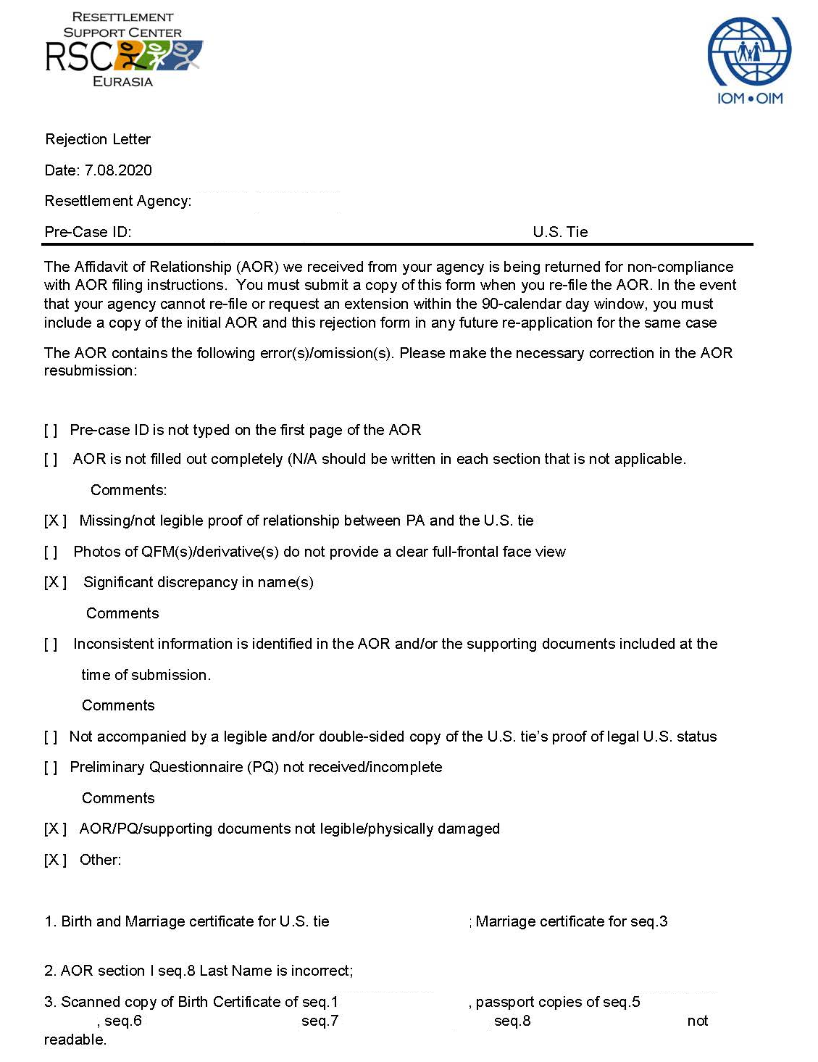
Rejection letter
If AOR is non-compliant or package is not complete - RSC issues Rejection letter
Rejection letter will contain reasons of rejection with details
Rejection letters will be uploaded into the respective RA’s folder on RSharenet according to naming convention
The date of issue of Rejection letter is the day when RSC informs RA on upload to RSharenet by e-mail
*See Program Announcement PA 2020-RA-03

Slide 15
Submitting Corrected / Amended AOR
Step 1
RA files Corrected / Amended AOR and uploads it together with Rejection letter to RSharenet within 90 calendar days
Step 2
RA files extension request if unable to meet the 90 calendar day deadline and submits it to the RSC
Step 3
RSC vets corrected application package and issues a rejection letter, if required
Step 4
In case of repeated rejection, RA has 90 calendar days to re-submit Corrected / Amended AOR
Note: RSC does not keep a record of rejected non-compliant AORs. RAs maintain their own record of non-compliant AORs.

Slide 16
Let’s start the QUIZ

Slide 17
Question 1. Which document is not a valid proof of U.S.tie's legal status in the US?
A
C
LPR card
I-94 form
B
D
US passport
Driver’s license

Slide 18
Question 2. Where should the Pre-case ID be put on AOR?
A
anywhere on AOR
B
on the top of first page of AOR
C
on the second page
D
Pre-case ID is not mandatory

Slide 19
Question 3.
File New AOR
File Corrected AOR
A
C
What should be done to add PA’s mother-in-law to the case?
File Amended AOR
PA should send written request to the RSC
B
D

Slide 20
Question 4.
What is the period for RA to submit Corrected AOR as of Rejection letter receipt date?
90 business days
90 calendar days
60 business days
60 calendar days
D
C
B
A

Slide 21
Question 5.
Which documents are needed to verify relationship between paternal half-brothers?
A
C
Driver’s license of US Tie
Their father’s birth certificate
B
D
Their birth certificates
Their passports

Slide 22
Question 6. As of what age applicants should fill PQ?
A
C
14 and above
18 and above
B
D
21 and above
All applicants despite of age

Slide 23
Question 7.
A
RSC will accept AOR and create a case
B
What will be RSC’s actions in case there is not enough documents to verify relationship between PA and U.S.tie in the AOR?
RSC will issue a Rejection letter to RA
C
RSC will contact RA to ask for missing documents
D
RSC will contact applicants to ask for missing documents

Slide 24
Question 8.
Can U.S. Tie include his aunt in AOR filed for his parents, if she fully depends on their support?
Only if aunt lives in the same country
A
No, this is not qualifying relationship
C
Yes, if they are same economic unit
B
Only if aunt has direct relatives in the US
D

Slide 25
Question 9.
File New AOR
A
B
File Amended AOR
What should be done to add PA’s new-born baby to the case?
C
File Corrected AOR
PA should send Birth Certificate to the RSC
D

Slide 26
Question 10.
Birth certificate of US Tie
Birth certificate of PA
A
C
What documents are needed to prove relationship between U.S. tie and beneficiary - his paternal Grandfather?
Birth certificate of US Tie and his father
PA’s passport
B
D

Slide 27
Question 11.
A
Their Birth certificates
B
What documents are needed to prove sibling relationship between a male U.S. tie and a female beneficiary who changed her last name after marriage?
Birth certificates of both, Birth and Marriage certificate of their mother
C
Birth and Marriage certificates of PA, Birth certificate of USTie
D
Their passports and Birth certificates

Slide 28
Question 12.
What is the correct format for applicants’ telephone numbers?
375 2723501090
C
N/A
A
B
Belarus +2723501090
D
3501090

Slide 29
Question 13.
Which one of the following relatives can not be considered as qualifying U.S. Tie?
A
C
Half-Sister
Grandmother
B
D
Cousin
Step-brother

Slide 30
Question 14.
To be eligible to file an AOR, U.S.tie should be of what age?
16 years old and above
21 years old and above
any age is applicable
18 years old and above
D
C
B
A

Slide 31
Annex 1
RSharenet naming conventions
New AOR
New_Pre-case ID_PA Last name_First name
Corrected AOR
Corrected_ Pre-case ID_ PA Last name_First name
Amended AOR
Amended_ Pre-case ID_ PA Last name_First name
Pre-allocation AOR transfer
Transfer_ Pre-case ID_ PA Last name_First name
Rejection Letter
Rejection_ Pre-case ID_ PA Last name_First name_Date of issue

