Slide 1
Accountability to Affected Populations
Implementation for Remote Placement partners
Notes:
Good afternoon everyone, thank you for joining us today. My name is Elizabeth Cirin Cione Remote Placement Coordinator here at USCCB and today we are going to discuss the Accountability to Affected Population Framework, commonly known as AAP, and how it relates to Remote Placement partners.
A few housekeeping items:
This webinar is pre-recorded. If you have any questions on the content of this webinar, please email us at remoteplacement@usccb.org

Slide 2
AAP Implementation
At the end of this webinar, you will be able to:
  Define Accountability to Affected Populations (AAP)
  Identify AAP requirements for remote placement partners
  Prepare for USCCB’s AAP Activities effective Oct. 1, 2020
Notes:
At the end of this webinar, you will be able to:
Define Accountability of Affected Populations (AAP)
Identify AAP requirements for remote placement partners
Prepare for USCCB’s AAP Activities effective Oct 1, 2020

Slide 3
Defining Accountability to Affected Populations
Accountability to affected populations (AAP) can be understood as “an active commitment by humanitarian actors and organizations to use power responsibly by taking account of, giving account to and being held to account by the people they seek to assist.”
The principle of accountability requires that humanitarian actors involve persons of concern meaningfully in key decisions and processes that impact them and ensure transparency by continuous communication.
Source: UNHCR, Handbook for Emergencies. Section on “AAP.” 2015.
3
Notes:
So what is AAP?
AAP can be understood as “an active commitment by humanitarian actors and organizations to use power responsibly by taking account of, giving account to and being held to account by the people they seek to assist.” In this context, resettlement agencies and community partners are considered humanitarian actors. The people we seek to assist include our refugee clients.
The emphasis here is being accountable and viewing our clients as being partners in the resettlement process. The goal is to shift the view from seeing clients as “us vs them” but instead seeing them as stakeholders in the process.
Next, The principle of accountability requires that humanitarian actors involve persons of concern meaningfully in key decisions and processes that impact them, and ensure transparency by continuous communication. Here the emphasis is on refugees taking a role in the resettlement process, sharing their feedback, both positive and negative. We are giving them a space to articulate concerns and be apart of their resettlement process.
These definitions of AAP come from the UNHCR Handbook for Emergencies section on AAP. https://emergency.unhcr.org/entry/42554/accountability-to-affected-populations-aap

Slide 4
IASC: Inter-Agency Standing Committee
The IASC was established in June 1992 in response to United Nations General Assembly Resolution 46/182 on the strengthening of humanitarian assistance. The forum includes UN and NGO humanitarian actors.
Source: Inter-Agency Standing Committee
In 2011, the IASC recognizing the fundamental importance of accountability to affected populations (AAP) in humanitarian response endorsed five commitments that leaders of humanitarian organizations will undertake.
Notes:
Before we go any further, I want to take a moment to introduce the IASC: Inter-Agency Standing Committee.
The IASC was established in June 1992 in response to United Nations General Assembly Resolution 46/182 on the strengthening of humanitarian assistance. The forum includes UN and NGO humanitarian actors.
In 2011, the IASC recognizing the fundamental importance of accountability to affected populations (AAP) in humanitarian response endorsed five commitments that leaders of humanitarian organizations will undertake.

Slide 5
Five AAP Principles
Build on Inter-Agency Committee’s Five Commitments to Accountability to Affected Populations.
Leadership/Governance – Ensure feedback mechanisms are integrated into strategies, proposals, monitoring and evaluation and training.
Transparency – Provide information to beneficiaries on procedures that affect them to ensure that they can make informed decisions and choices.
Feedback and Complaints – Seek the views of affected populations to ensure that feedback mechanisms are streamlined, appropriate and robust.
Participation – Enable affected populations to play an active role in the decision-making processes through the establishment of clear guidelines.
Design, Monitoring and Evaluation – Feed learning back into the organization.
Source: Inter-Agency Standing Committee Emergency Directors Group (EDG). Protection and Accountability to Affected Populations in the Humanitarian Programm Cycle. 2016
5
Notes:
Let’s take a look at the five commitments.

Slide 6
The USCCB/MRS Approach
“USCCB’s accountability to affected populations is rooted in an approach which ensures ongoing and transparent and communication with clients and the communities in which they live to develop a relationship that encourages open feedback. We recognize the value of a community-based approach and plan to put it at the center of our refugee resettlement programming.”
Notes:
Accountability to Affected Populations is a Requirement in PRM’s Cooperative Agreement with Refugee Agencies for effective 2018. PRM requires USCCB to develop an AAP operational framework, which they keep on file. Here is a little bit of the framework which explains USCCB’s approach.
USCCB’s accountability to affected populations is rooted in an approach which ensures ongoing and transparent communication with clients and the communities in which they live to develop a relationship that encourages open feedback. We recognize the value of a strengths-based and community-based approach and plan to put it at the center of our refugee resettlement programming.

Slide 7
AAP Requirements for Remote Placement Partners
Submission of AAP Checklist
  Grievance Policy
  Client Feedback Mechanism
  Acknowledgement of PSEA
  Acknowledgement of MRS Case Management Manual
Notes:
With that approach in mind, we have some requirements for remote placement partners to ensure compliance with AAP principles. Each fiscal year, USCCB seeks to collect a new AAP Checklist from each community partner. This is usually timed with the start of the new fiscal year and release of the new Cooperative Agreements. For FY 2020, we were waiting for the new Cooperative Agreement but as you all know, we have been in a cost-extension period since October 1, 2019. Although as of July 2020, we still are in a cost-extension period, we are going to proceed with requesting new AAP Checklists on October 1, 2020. Let’s take a look at what we will be requesting.

Slide 8
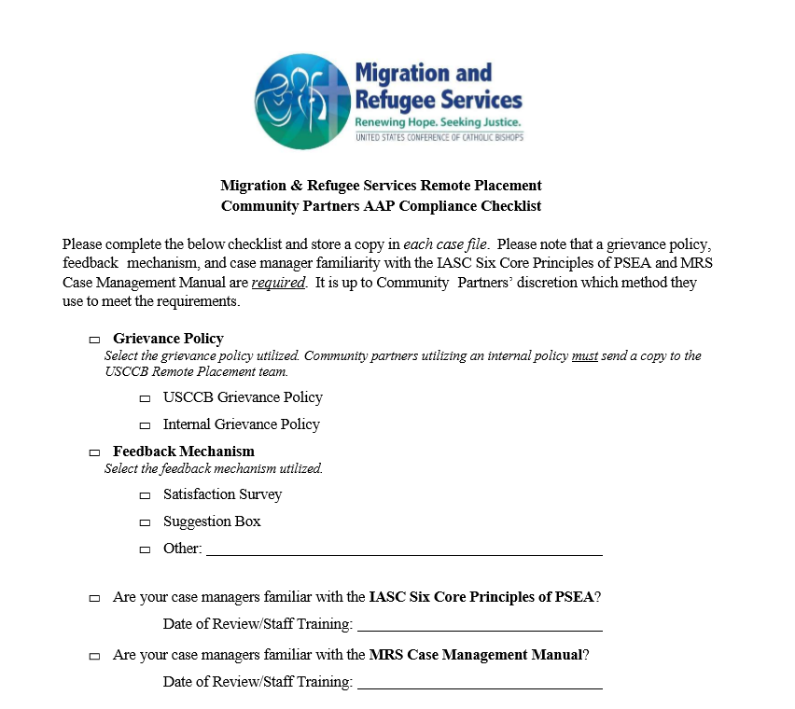
AAP Compliance Checklist
Notes:
Here is a screenshot of the updated AAP Checklist which will be sent out to Remote Placement partners on October 1, 2020. So as you can see, we ask that you complete the below checklist, and store a copy in each case file.

Slide 9
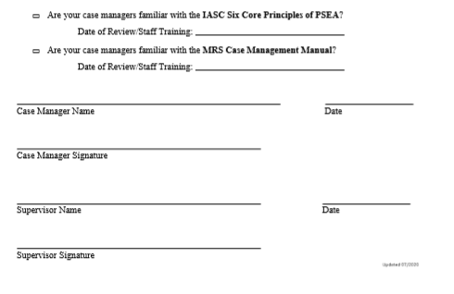
AAP Compliance Checklist
Notes:
There is also a signature portion of the AAP Checklist, for both case manager and supervisor. Your agency’s staff may have different titles, the primary staff that are working on the resettlement program should sign as case manager and their managers should sign as supervisors.

Slide 10
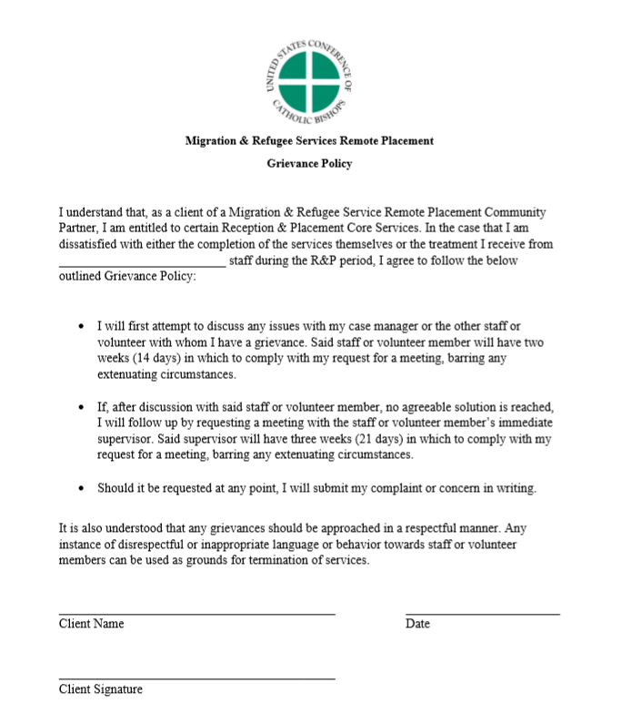
Grievance Policy
USCCB Grievance Policy
Internal Grievance Policy
  Please send copy with your checklist
Notes:
The first thing the AAP Checklist asks about is the grievance policy. The purpose of a grievance policy is to provide a mechanism for clients to raise a grievance arising from their resettlement experience. Grievance policies should reiterate the right of the client to issue a grievance and provide a path to ensure that such grievances are dealt with promptly and fairly.
USCCB has a sample policy you are welcome to use, the screenshot is here on your screen. You are also welcome to use your own agency’s grievance policy if you wish, but please send us along a copy of the policy so we can review.
We recommend introducing the grievance policy to all clients at the start of their R&P period, such as during client intake, to ensure that clients understand their rights and responsibilities as they move forward with their service provision.
The grievance policy is available on MRSConnect.

Slide 11
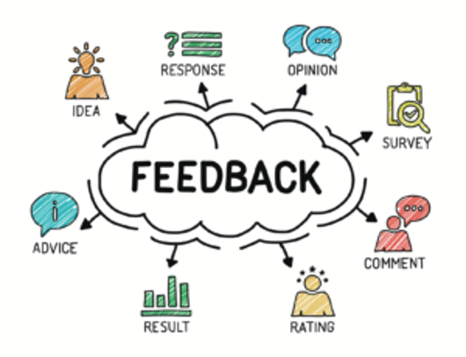
Client Feedback Mechanism
Satisfaction Survey
Suggestion Box
Other
  Please include details
Notes:
Next, the checklist asks what your agency has in place to solicit client feedback. Feedback is one of the most important aspects of AAP as it allows agencies to seek opinions and thoughts from the population they directly serve. Offering clients the space to provide their feedback keeps the agency accountable and helps identify existing best practices.
USCCB has a sample satisfaction survey that we encourage partners to use. You are welcome to utilize other methods of obtaining client feedback, but we ask that you detail what methods you use on the checklist.

Slide 12
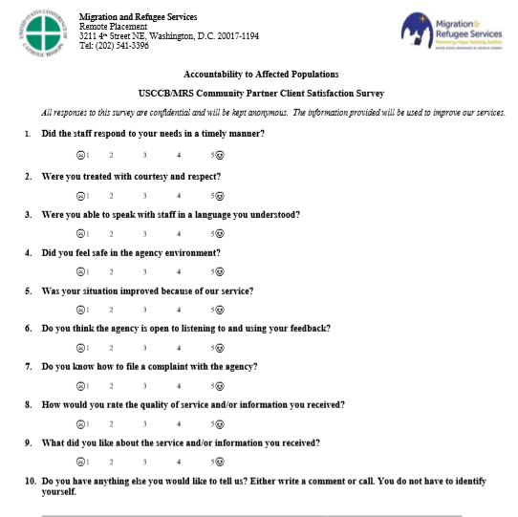
USCCB Client Satisfaction Survey
Notes:
Here is the sample USCCB Client Satisfaction Survey. We recommend completing this survey with clients at the end of their service provision. Clients may ask to keep their feedback anonymous, but these surveys should be stored and analyzed to review and filter back into future programming. Make sure that an interpreter is available for clients if needed. The client satisfaction survey is available on MRSConnect.

Slide 13
PSEA
Effective October 1, 2020, we will be asking partners to confirm familiarity with the IASC Six Core Principles Relating to Sexual Exploitation and Abuse (PSEA)
We have not asked for this before, so let’s spend a few minutes learning about PSEA.

Slide 14
PSEA Terminology
“Sexual exploitation - any actual or attempted abuse of a position of vulnerability, differential power, or trust, for sexual purposes, including, but not limited to, threatening or profiting monetarily, socially or politically from the sexual exploitation of another.”
“Sexual abuse - the actual or threatened physical intrusion of a sexual nature, whether by force or under unequal or coercive conditions.”
Source: WHO, Sexual Exploitation and Abuse Prevention and Policy Response.
Notes:
What exactly is meant by Sexual Exploitation and Abuse? It’s important to understand the definitions.
DEFINITIONS….These definitions come from the World Health Organization’s Sexual Exploitation and Abuse Prevention and Policy Response.
PSEA is NOT the same as sexual harassment. Your agency most likely has a sexual harassment policy, but it might not include prevention against sexual exploitation and abuse, which is why we are asking for acknowledgement of the IASC 6 Core Principles of PSEA. Sexual exploitation and abuse occurs against a vulnerable beneficiary, whereas sexual harassment in the workplace is characterized by the making of unwelcome and inappropriate sexual remarks or physical advances in a professional or social situation. Sexual harassment often occurs when power differentials between staff members are abused.

Slide 15
IASC Six Core Principles Relating to Sexual Exploitation and Abuse
“Sexual exploitation and abuse by humanitarian workers constitute acts of gross misconduct and are therefore grounds for termination of employment.
Sexual activity with children (persons under the age of 18) is prohibited regardless of the age of majority or age of consent locally. Mistaken belief regarding the age of a child is not a defense.
Exchange of money, employment, goods, or services for sex, including sexual favors or other forms of humiliating, degrading or exploitative behavior is prohibited. This includes exchange of assistance that is due to beneficiaries.
Notes:
Let’s take a look at the Six Core Principles of PSEA, which we are requiring case managers to review effective October 1, 2020.

Slide 16
IASC Six Core Principles Relating to Sexual Exploitation and Abuse
Any sexual relationship between those providing humanitarian assistance and protection and a person benefitting from such humanitarian assistance and protection that involves improper use of rank or position is prohibited. Such relationships undermine the credibility and integrity of humanitarian aid work.
Where a humanitarian worker develops concerns or suspicions regarding sexual abuse or exploitation by a fellow worker, whether in the same agency or not, he or she must report such concerns via established agency reporting mechanisms.
Humanitarian workers are obliged to create and maintain an environment which prevents sexual exploitation and abuse and promotes the implementation of their code of conduct. Managers at all levels have particular responsibilities to support and develop systems which maintain this environment.”

Slide 17
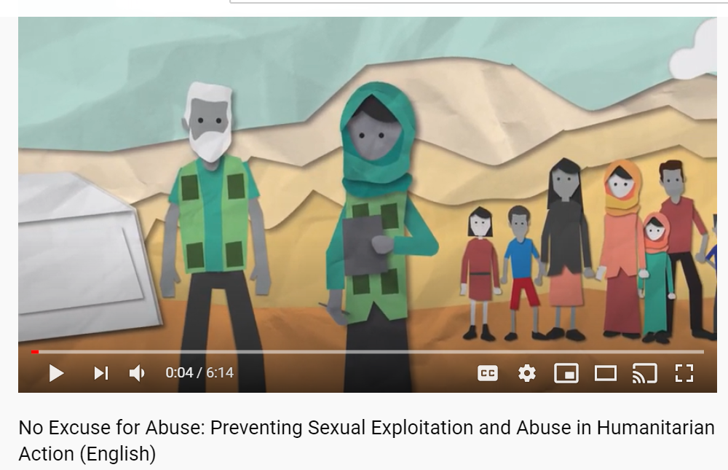
Learning more about PSEA
For examples on PSEA, we recommend watching InterAction’s video hosted on Youtube, entitled: “No Excuse for Abuse: Preventing Sexual Exploitation and Abuse in Humanitarian Action (English)”

Slide 18
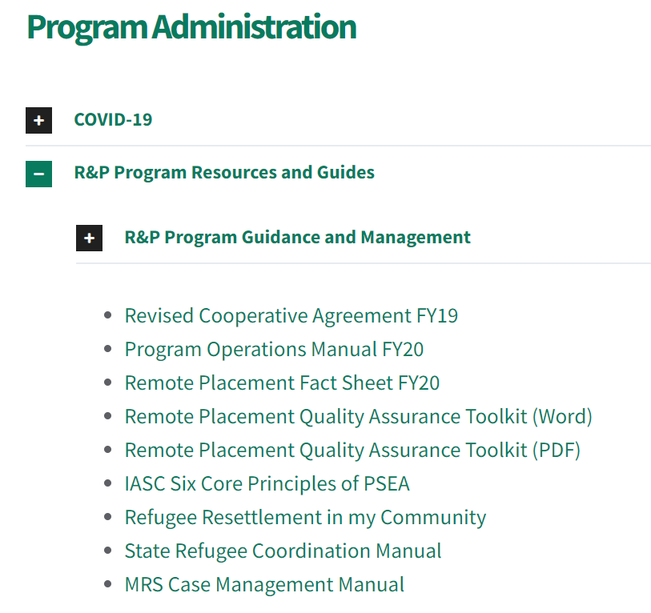
PSEA
  These principles are stored on MRSConnect, we encourage you to review and start ensuring your staff are aware of the principles in anticipation of October 1.
    Can be achieved by having staff review the principles, having principles discussed at a staff meeting, and having staff watch this webinar.
  The 2020 AAP Checklist will ask for the date of staff review/training.
  We encourage you to look into ways you can incorporate the six core principles of PSEA into your agency’s code of conduct, training materials and other relevant programming.

Slide 19
MRS Case Management Manual
  This manual provides the basic principles and ethics of social work, and how they apply to everyday client situations.
  This manual is on MRSConnect, we encourage you to review and start ensuring your staff are aware of the manual in anticipation of October 1.
  The 2020 AAP Checklist will ask for the date of staff review/training.
Notes:
Finally the AAP Checklist asks for agencies to confirm staff familiarity with the MRS Case Management Manual.

Slide 20
Ensuring accountability
Requiring a grievance policy, feedback mechanism, and familiarity with PSEA and case management principles helps us to fulfill the five AAP principles we discussed earlier:
  Leadership, Transparency, Feedback and complaints, Participation and design, Monitoring and evaluation.

Slide 21
What’s Next?
Start reviewing the USCCB Grievance Policy, Client Satisfaction Survey, Six Core Principles of PSEA and MRS Case Management Manual on MRSConnect
More information on obtaining client feedback can be found in our new Quality Assurance Toolkit, also on MRSConnect
Decide if you will be implementing the USCCB sample forms or using your own
Plan to have staff review and/or be trained on PSEA and the MRS Case Management Manual in anticipation of October

Slide 22
Checklist Collection
USCCB’s Remote Placement team will be contacting agencies after October 1, 2020 to remind them of the requirements, provide copies of the documents and provide a date for the returned checklists.

Slide 23
Questions? remoteplacement@usccb.org

