Slide 1
Refugee and SIV Pipeline, Allocations, and Placement
U.S. Conference of Catholic Bishops
Migration & Refugee Services
Processing Operations
April 7, 2020

Slide 2
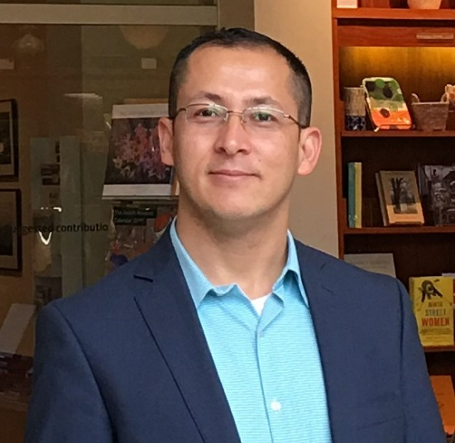
Hussain Kazimi
Pre-arrival Case Manager
United States Conference of Catholic Bishops
Migration and Refugee Services
Processing Operations

Slide 3
Webinar Objectives
Brief overview of refugee and SIV admissions, pipeline and arrival
Describe the pre-arrival refugee and SIV application and resettlement process
Understand the allocations process through which cases are allocated to RAs
Review case placement, factors USCCB use when making placement decisions
Explain USCCB's management of affiliates’ refugee and SIV capacity
Quick update on refugee and SIV travel
Some new updates and reminders
Questions and Comments

Slide 4
Approved Admissions Ceiling & National Arrival
FY20 Refugee Admissions Ceiling: 18,000
  Nationally, we are at about 41% capacity based on arrived. That is about 7,400 refugee arrivals to date
FY20 SIV Approved Admissions: 10,000
  Nationally, we are at about 77% capacity based on arrived. That is about 7,650 SIV arrivals as of April 6 (including walk-in SIVs)
Over 80% of overall refugee arrivals are US Tie cases
Approximately 95% of overall SIV arrivals are US Tie cases (mostly Afghans)
Refugee Arrivals by Top Five Country of Processing: Ukraine, Kenya, Tanzania, Malaysia, Thailand, Turkey
Refugee Arrivals by Top Five Nationality: Ukrainian, Congolese, Burmese, Afghan, Iraqi
SIV Arrival Hotspots: Sacramento, CA, San Antonio, TX, Arlington, VA, Seattle, WA

Slide 5
USCCB Approved Refugee and SIV Capacity and Arrival
USCCB’s Approved Refugee Capacity: 3,355
  USCCB is currently at about 43% capacity based on arrived. That is about 1,435 refugee arrival to date
USCCB’s Approved SIV Capacity: 1,418
  We are currently at 85% SIV capacity. That is about 1,210 SIV arrival to date (including walk-in SIV arrivals)
Sites that have received at least over 50% of their refugee arrival:
Rockford, IL, Jacksonville, FL Amarillo, TX, Sacramento, CA
SIV Arrival Hotspots: Sacramento, CA, San Antonio, TX, Arlington, VA

Slide 6
Pre-Arrival Refugee Resettlement FACTS
  Very few refugees for whom resettlement is considered the most appropriate durable solution can be referred for resettlement
  Refugees can NOT apply for resettlement themselves
    Only the most vulnerable refugees are considered for resettlement by UNHCR
    Refugees referred for resettlement must fit vulnerability category: medical needs, women & girls at risk children at risk survivors of violence or torture etc.
  Countries that participate in refugee resettlement decide which refugees to admit
  In addition to UNHCR’s screening, the United States has its own requirements and vetting process, whether or not to accept a refugee

Slide 7
Pre-Arrival Refugee Resettlement Process: The Basics
  UNHCR and other overseas processing entities identify and refer refugee cases for resettlement in the U.S.
  RSCs submit cases ready for allocation to RPC
  RPC generates the allocations packet, which includes new cases ready to be assured by a resettlement agency (RA)
  RA representatives download the allocations packet and prepare for the allocations meeting
Pre-Screening (RSC)
Travel/Arrival to the U.S. (IOM)
DHS interview (USCIS)
Security Checks (feds)
Medical Checks/Cultural Orientation (IOM/RSC)
Verification & Assurance (RA)
Allocations (RPC)

Slide 8
Pre-Arrival SIV Application Process: The Basics
Eligibility and Program Requirements:
Apply for Chief of Mission (COM) approval (the first step in the process)
  Evidence of Afghan Nationality, (Afghan passport, employment badges etc. required)
  Proof of employment by the U.S. government in Afghanistan for at least two years
  Favorable Letter of Recommendation from direct, U.S. citizen supervisor
  Statement of threats received as a consequence of employment with the U.S. government
Application, required documents must be submitted online

Slide 9
Pre-Arrival SIV Application Process (Continued)
Chief of Mission (COM) approval letter, must confirm an applicant’s:
  Employment by or on behalf of the U.S. government for a period of not less than two years
  Review of records to confirm employment and faithful and valuable service to the U.S. government
  Experience of ongoing serious threat as a consequence of employment by the U.S. government.
Petition with USCIS by submitting required documents i.e. COM approval, passport, proof of employment
  USCIS approves petition and forwards to US Embassy/Consulate for visa interview
Applicants attend an in-person visa interview at a U.S. Embassy or Consulate
  Upon successful visa interview and completion of “administrative processing” applicants receive their visa
Travel to the United States through IOM or self-arranged flight
  Only SIVs can choose to make their own travel arrangements to the U.S.

Slide 10
Weekly Allocations Meeting: The Basics
Process by which refugee and SIV cases are distributed for resettlement across the Nine national resettlement agencies for placement within their networks
Weekly meeting facilitated by the RPC with a representative from each RA
One representative from each nine RAs chooses their network’s cases at the meeting
Meeting is structured and rules-based
Some of the rules are beneficial to USCCB, others are not
Highly dependent on overseas processing trends
Nine U.S. National Resettlement Agencies:
CWS
DFMS
ECDC
HIAS
IRC
USCRI
LIRS
USCCB
WR

Slide 11

Meeting Structure
Weekly Allocations Meeting (Continued)
Rounds
No US Tie Medical Cases (Refugee)
(SIV uncommon)
Picking order rotates weekly
All RAs take up to the same prescribed number of individuals each round
Then, it is the next agency’s turn
Once a RA is out of numbers in their target share, they will be skipped until all cases are selected
Process continues until all cases are selected
Cases in all pools (medical, UST, No UST) are selected this way
US Tie Cases
(Refugee)
No US Tie Cases (Refugee)
(SIV uncommon)
US Tie Cases
(SIV)

Slide 12
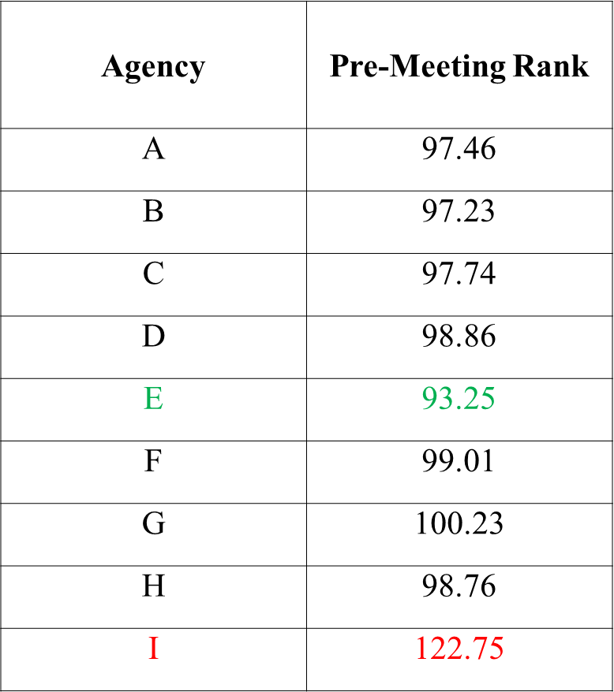
“Drive to Parity:“ Pre-Meeting Rank → Target Share
Agency | Target Share
A | 12
B | 3
C | 4
D | 2
E | 50
F | 9
G | 0
H | 12
I | 0

Slide 13
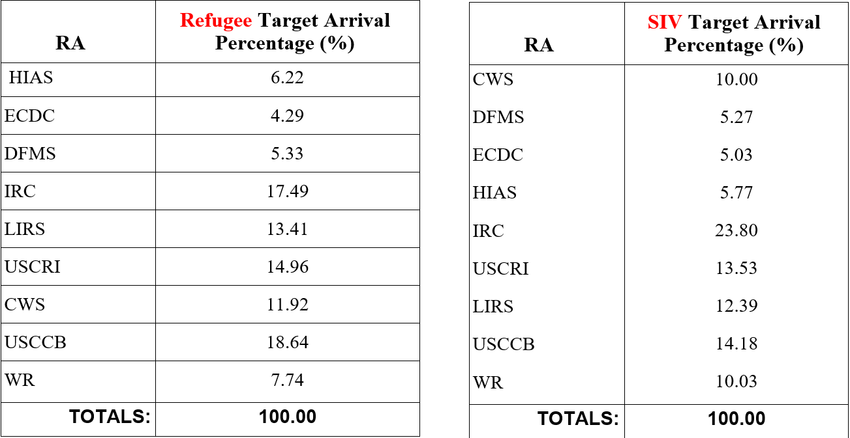
Target Arrival Percentage (%)

Slide 14
Cases Allocated in the Meeting vs. Pre-allocated Cases
Not Allocated in the Meeting (pre-allocated before meeting)
Allocated during the Meeting
M3 cases (ARM)
M4 cases (URM)
Family reunification cases: P3 AOR, Lautenberg RIF
  All of the above are “predestined,” or automatically assigned, to a resettlement agency.
Cases with cross-references already assured by a RA
U.S. Tie (UST) cases
  Visa 93 cases (I-730 beneficiaries) are allocated like any UST case. Unlike AOR cases, they are not automatically assigned to the agency that assisted them.
No UST cases
Medical cases

Slide 15


US Tie Pool Case Allocation Structure
Standalone
Only affiliate in one city
Dual Locations
Two affiliates in one city
Special Rounds
Set apart from normal rounds (many reasons)
Sacramento
Anchorage Newport News, Dayton
Lincoln
Rockford
Fort Wayne
Des Moines
Salt Lake
City
Louisville
Indianapolis
  Remaining cities allocated in normal rounds
  Atlanta
    Buffalo
    Chicago
    Houston

Slide 16
Case Placement & Factors used to Place No US Tie Cases
Each week after allocations, the Pre-Arrival Case Managers (PACMs) hold a placement meeting to identify an appropriate affiliate for every No US Tie case
PACMs review biodata forms to ensure US Tie cases and No US Tie cases with assured/arrived cross-references are placed with the right affiliate
PACMs also go through case’s medical forms to review if there are cases with medical conditions, i.e. significant medical condition (SMC) forms
Tools used for placement:
  RP Placement Assessment
  Active assurance and arrivals by each diocese
  Special grants or programs available at an affiliate
  Input from other segments (performance)

Slide 17
Case Placement & Factors used to Place No US Tie Cases (Continued)
  Placement assessment
  Language capacity
  Nationality
  Case size
  Vulnerable case?
  Communities
  Medical conditions
  Placement assessments can be updated by an affiliate at any time
  Active assurance, arrivals & pipeline
  Which affiliates are lower than the network average?
NOTE: The majority of refugee and SIV cases allocated to resettlement agencies are US tie cases. The number of No US tie “Free” refugee and SIV cases allocated to RAs are very limited

Slide 18
USCCB’s Management of Affiliates’ Refugee and SIV Capacity
Arrivals have been largely unpredictable due to several different factors:
  FY20 Presidential Determination (PD) does not break down refugee admissions numbers based on geographic regions as had been done in the past
  FY20’s PD allocates refugee admissions into groups of “special humanitarian concern” i.e. Refugees fleeing religious persecution, P2 refugees from Iraq, refugees from Northern Triangle etc.
Due to unpredictable arrival trends, USCCB has modified most affiliates’ refugee and SIV capacities to better align with current arrival trends
Predicting refugee arrival trends under the new allocation categories is very challenging for resettlement agencies
USCCB is nearing its approved SIV capacity and has made several SIV capacity adjustments to accommodate arrivals in hotspot areas

Slide 19
USCCB’s Management of Affiliates’ Refugee and SIV Capacity (Continued)
  Refugee admissions ceiling is unlikely to be adjusted, PRM might increase SIV capacity
  PRM views USCCB’s total capacity collectively NOT by individual affiliate
    USCCB is expected to shift affiliate capacity around (if necessary)
    USCCB tend to reduce capacity from standalone sites first
    If necessary, PRM will approve capacity increase for standalone sites
    If standalone site’s “spare” capacity is exhausted, USCCB tend to reduce capacity from sites in other locations that have other affiliates
    Refugee and SIV arrivals/cases on ABN (including walk-ins) for a site that has reached/surpassed capacity, will have to be transferred to other same-city affiliates that still have capacity
NOTE: USCCB recognize that it does not seem fair to transfer additional arrivals to other RAs that have capacity, but PRM treats USCCB’s capacity collectively, not by individual affiliate

Slide 20
Refugee and SIV Travel Update Due to COVID-19
PRM has extended travel suspension for refugee and SIV arrivals (including FTJ - I-730 refugees) through the end of April.
Cases booked in April (with the exception of emergency cases as approved by PRM on a case by case basis) will be cancelled and will not travel or be rebooked.
As of this time, May bookings are not being cancelled, unless they are cancelled by the airlines or host government restrictions
USCCB will provide further travel updates regarding arrivals in May and beyond once available
NOTE: Some SIVs might travel by their own arranged flight, or your office might be contacted by certain walk-in SIVs who might have arrived in the U.S. before travel restrictions were made.
All inquiries related to refugee travel may be sent to Refproc@usccb.org

Slide 21
Some New Updates on US Tie Case Status Inquiries
USCCB can no longer share case status information that is assured by an affiliate, but the assurance has expired
  No further information can be shared with a US tie until the assurance is renewed.
  Affiliates should re-direct inquiries on cases with expired assurances to the RSC.
Exceptions: Affiliates can inquire and provide case information to U.S. ties on specific P2 and P3 categories:
  P2 Lautenberg applicants
  P2 I-130 Iraqi and Syrian applicants
  All P3 categories in reference to assisting the petitioner with:
    DNA testing
    AOR discrepancy letters
    AOR rejection letters
    RAVU decision letters
NOTE: If an inquirer is not listed as a US Tie on a case, we cannot share any information with that inquirer, affiliates may advise the inquirer to contact the potential refugee applicant for any further information

Slide 22
A few Reminders
If your site has a case is on ABN, but their medicals have expired, ask your PACM for the updated medical forms
  your PACM can follow up with the RSC/RPC to receive the updated medical forms
NOTE: We do not receive medical forms for walk-in SIVs, Visa-93 and certain Amerasian cases
USCCB is unable to check the status of any unallocated case
USCCB is also unable to request transfer, if a case has not been allocated yet
  Affiliates may follow up with their designated PACM to check whether a case has been allocated
  Visa 93 cases (I-730 beneficiaries) are allocated like any US Tie case
Family reunification cases: P3 AOR, Lautenberg, and cases with cross-references already assured by an RA will automatically be allocated to the appropriate RA
Contact your Pre-arrival Case Manager regarding all pre- and post-arrival transfers
For out-migration questions, contact your designated Field Support Coordinator (FSC)

Slide 23
USCCB/MRS Processing Operations Team
Colleen Tighe Director, Processing Operations Ctighe@usccb.org (202) 541-3464 | Elizabeth Cirin Cione Remote Placement Coordinator Ecirion@usccb.org (202) 541-3461 | Austin Hamling Pre-arrival Case Manager, Family Reunification Lead Ahamling@usccb.org (202) 541-3463
Hussain Kazimi Pre-arrival Case Manager, Protection Lead HKazimi@usccb.org (202) 541-3462 | Emily McDonnell Remote Placement Specialist Emcdonnell@usccb.org (202) 541-3327 | Aya Turki Refugee Transportation Specialist aturki@usccb.org (202) 541-3011

Slide 24
Questions
and
Comments?

